Slide 1

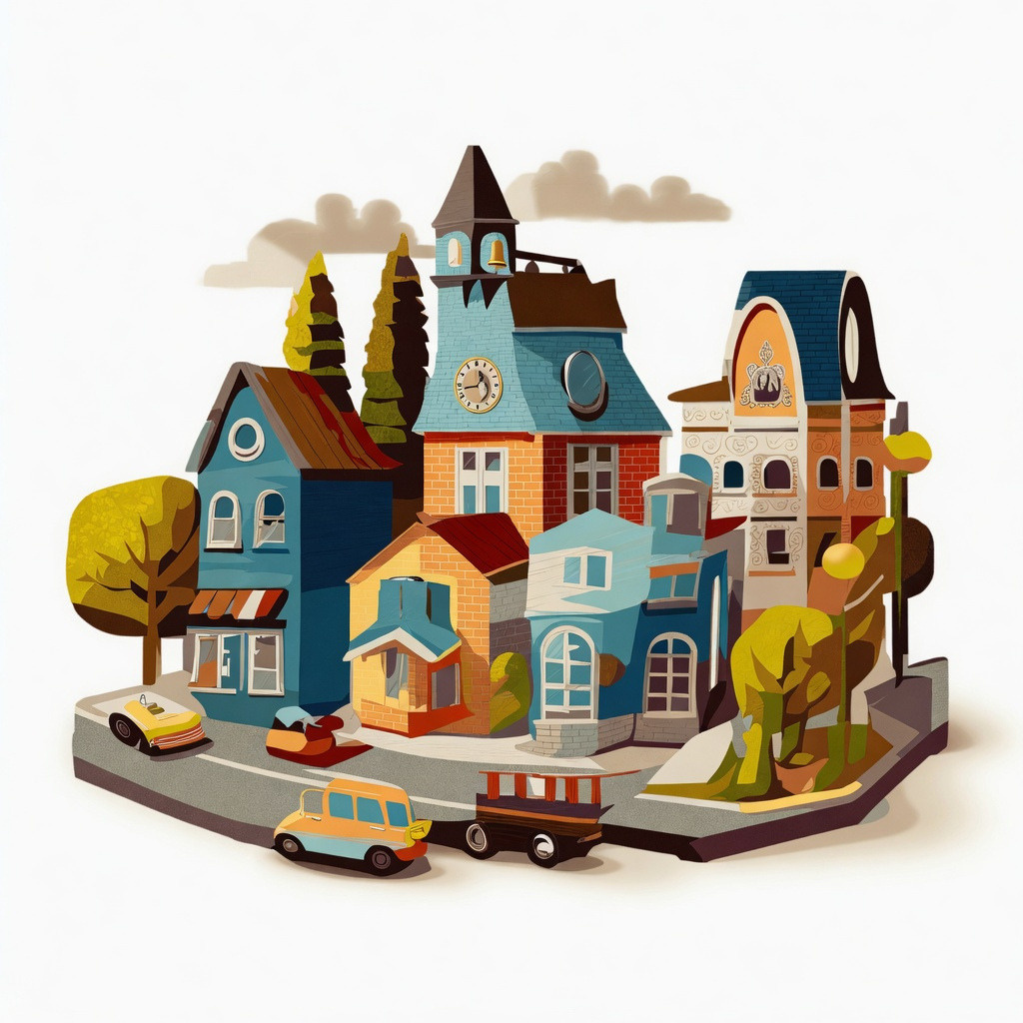

Presentation Topic
Town Life
Page 1

Slide 2




Course Name: Computer Graphics Lab
Course code : CSE412
Yamina Islam
Lecturer
Department Of CSE
Daffodil International University
Page 2

Slide 3


OUR TEAM: BUG_OVERFLOW
MD. MAHIDUL ISLAM
0242310005101289
MD. TAMIM ISLAM
0242310005101285
Page 3

Slide 4
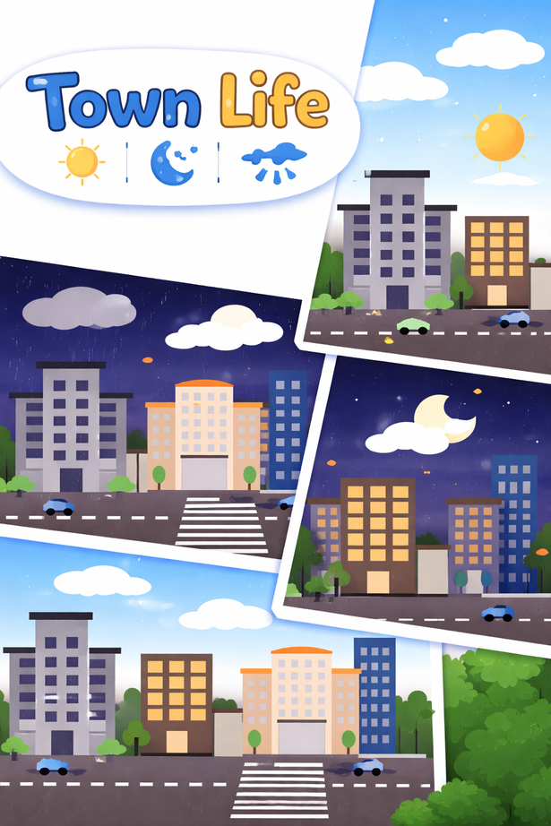
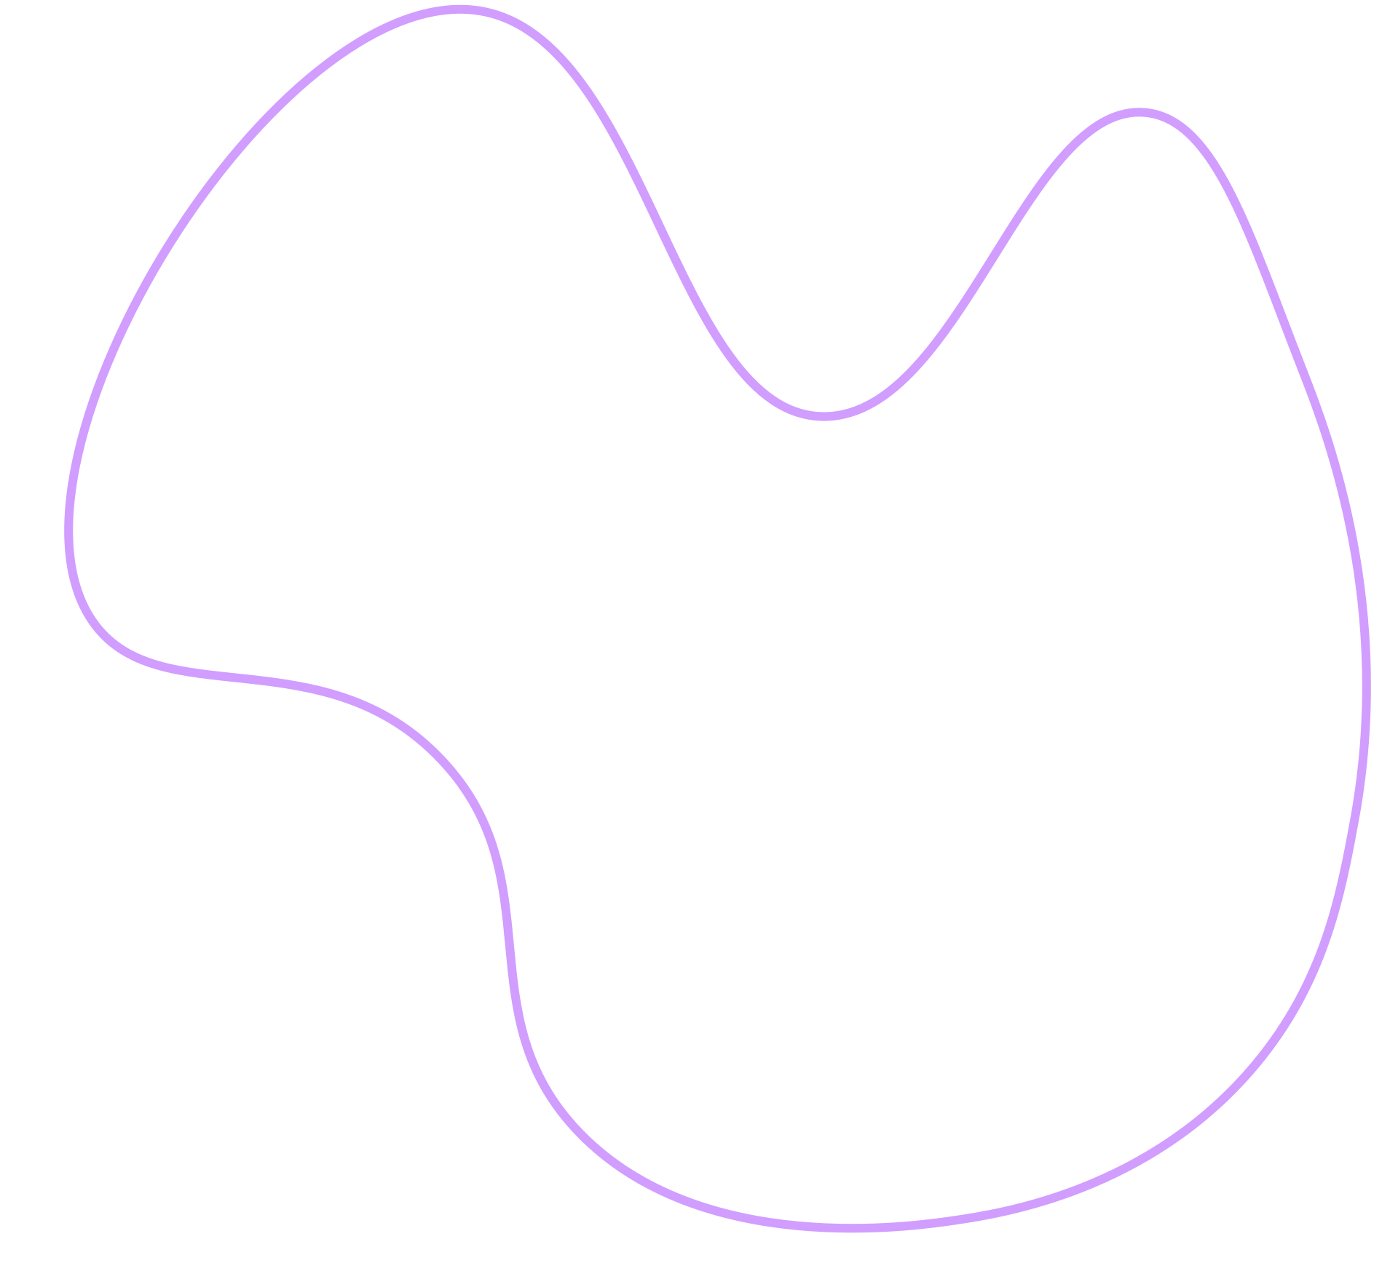

Introduction
Town Life is a dynamic computer graphics project that brings a small urban environment to life through animation and interactivity.
Using OpenGL and GLUT, it showcases dynamic scenes with changing weather conditions like day, night, and rain, along with moving elements such as cars and clouds.
The project highlights how simple graphics techniques can create an interactive and realistic scene.
Page 4

Slide 5


Objective
The main objectives of this project are:
Implementing classic graphics algorithms to construct visual elements
Developing smooth animations for objects like vehicles, clouds, and rainfall
Creating a dynamic environment with multiple weather conditions (day, night, rain)
Enhancing user experience through interactive controls
Page 5

Slide 6



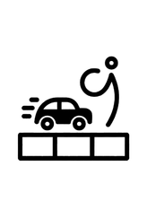


Methodology
Primitives & Algorithms
Animation Techniques
Dynamic Effects
DDA & Bresenham’s line drawing
Triangle Fan circle drawing
Polygon & Quad primitives for buildings & cars
Moving object based animation
Continuous car movement with reset
Multi-speed cloud drifting
Day/Night mode (sky, sun/moon, lamp)
Star generation for night scene
Real-time keyboard interaction
Page 6

Slide 7


Future Work
Add traffic signals and pedestrian animation
Implement lighting and shading effects for realism
Introduce sound effects (rain, traffic, environment)
Upgrade from 2D to 3D environment using modern OpenGL
Page 7

Slide 8
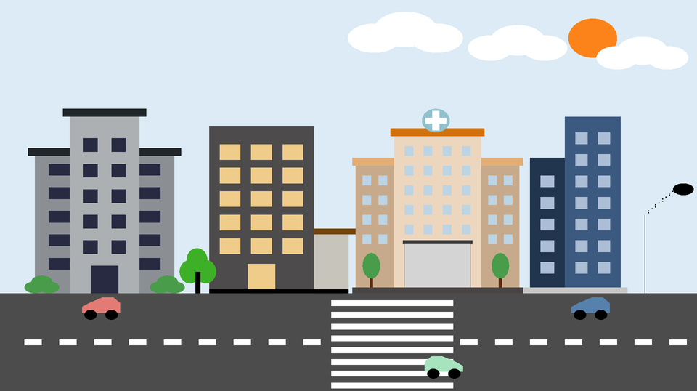
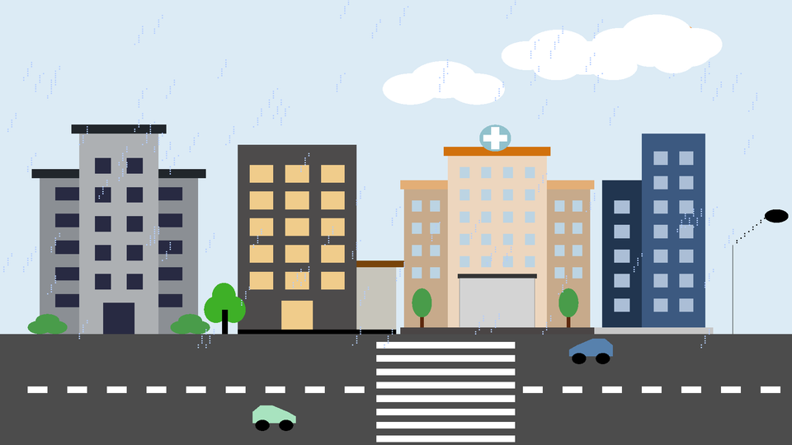
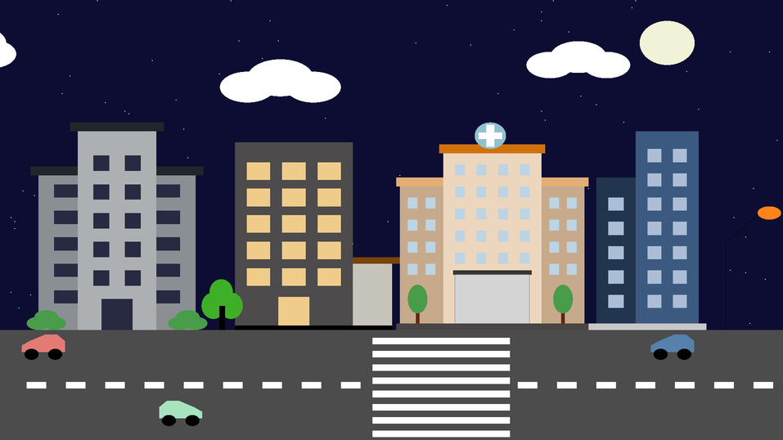
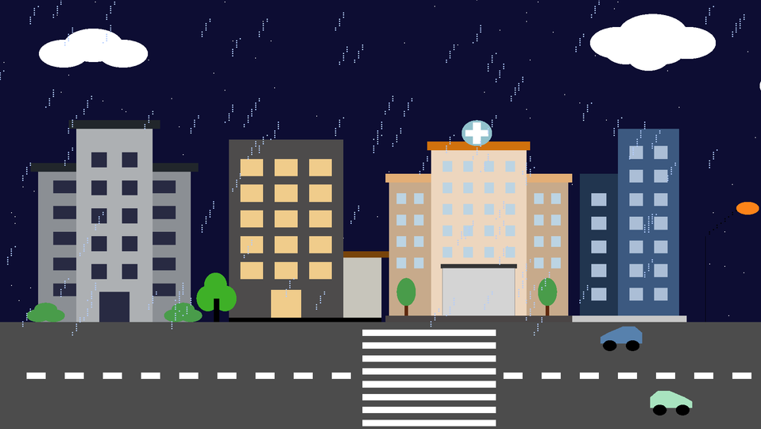
Interface
Sunny Day
Rain Mode
Night Mode
Rain Mode
Page 8

Slide 9
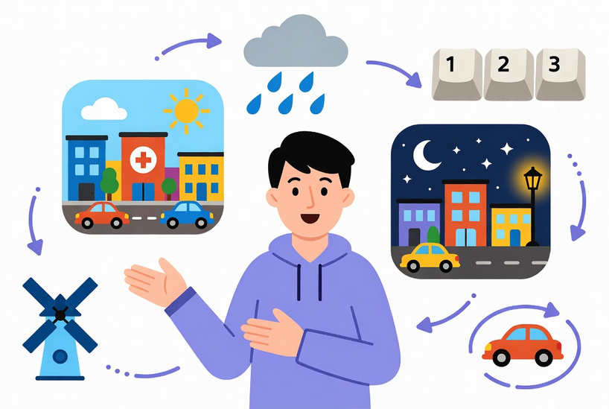


Outcome
The project delivers a dynamic town simulation with smooth transitions between day, night, and rainy conditions. Animated elements like cars, clouds, and rain create a lively and realistic environment.
It effectively demonstrates the practical use of computer graphics concepts, combining algorithms, animation, and interactivity to build a real-time visual system.
Page 9

Slide 10
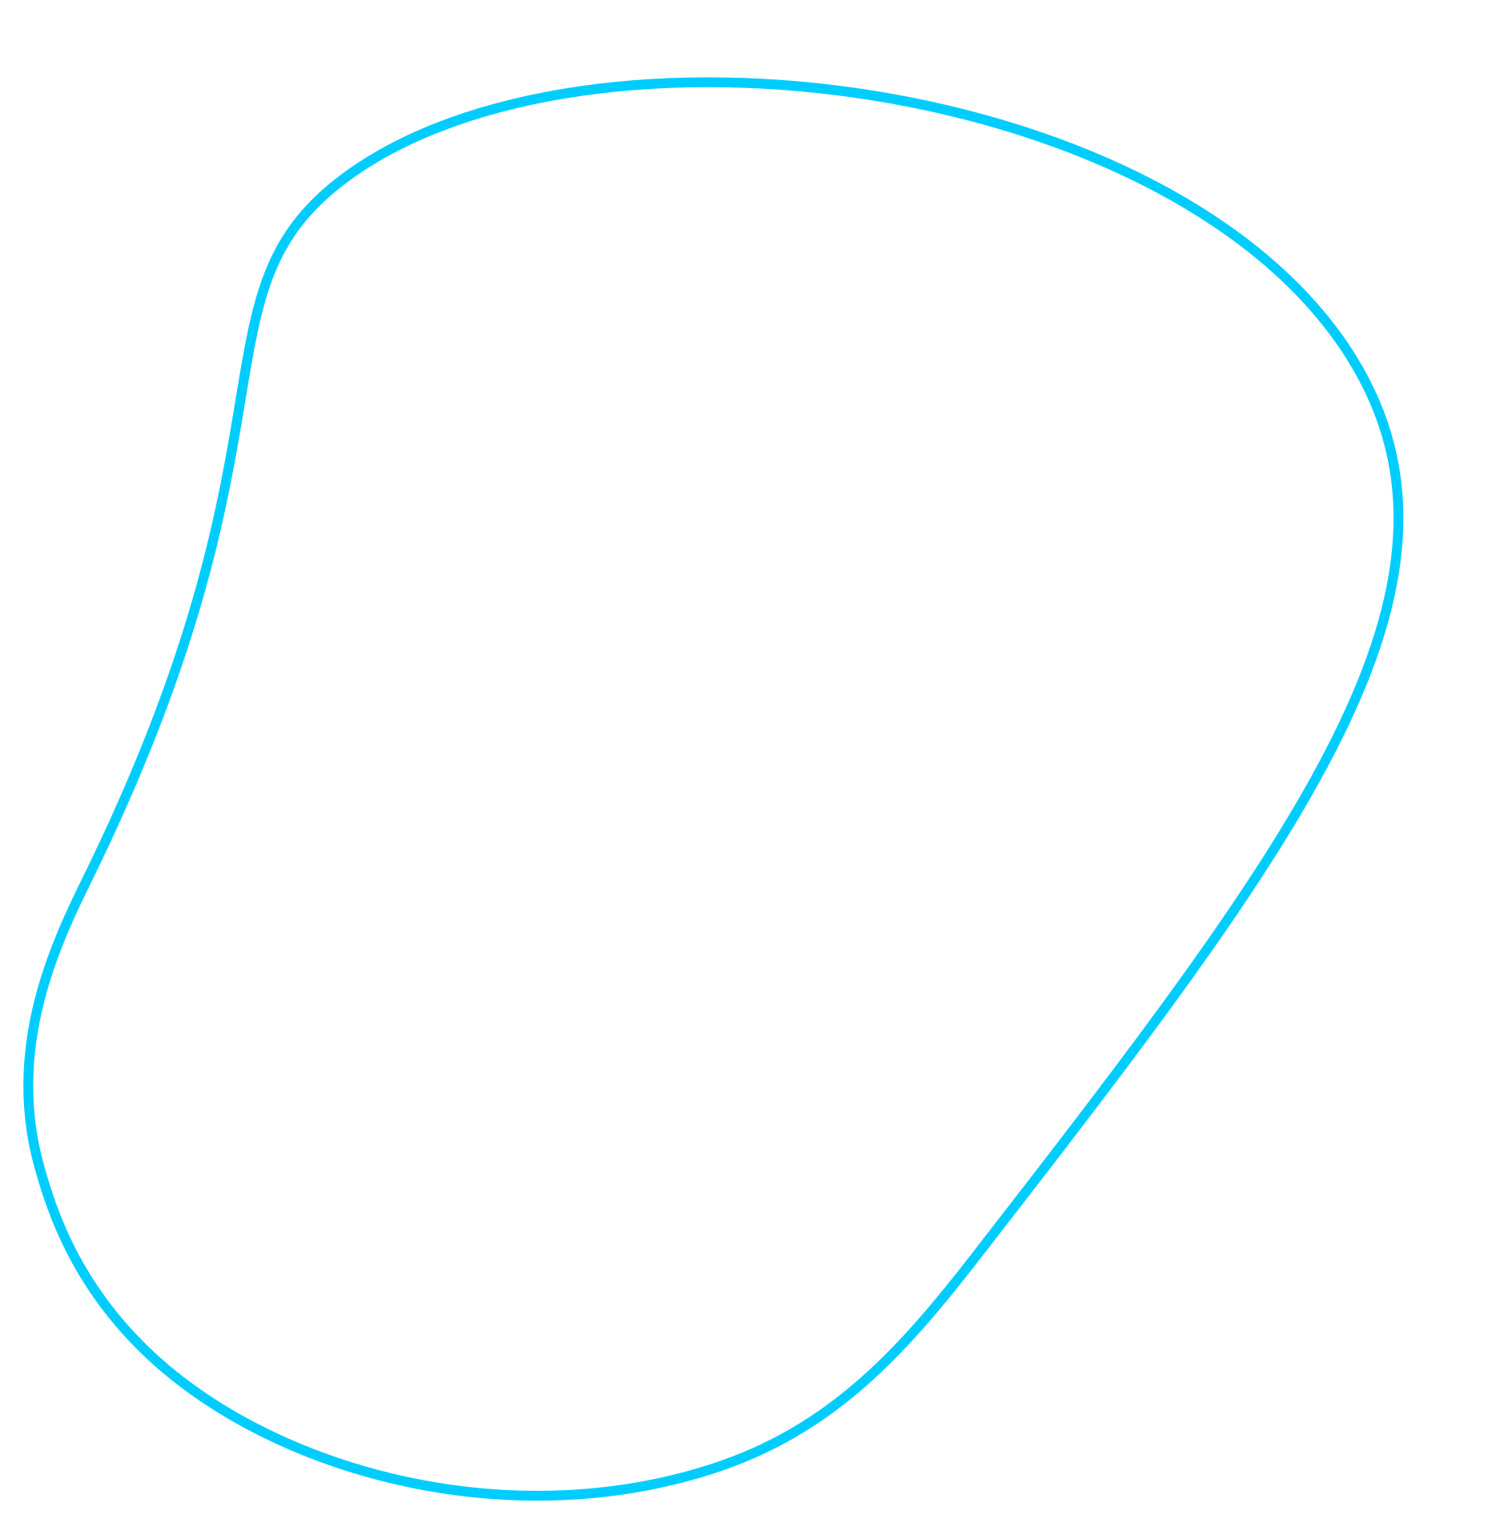




Thank You
Page 10

